Slide 1



Information decoding about elderly people cognitive state from EEG activity during sleep
Final Bachelor Thesis: Computer Engineering
Information Systems
Author: Óscar Brizuela García​
Director: María Sierra Torralba
Co-director: Eduardo López-Larraz​
Associate professor: Javier Mínguez Zafra​
School of Engineering and Architecture– University of Zaragoza
2024/2025

Slide 2
Agenda
Introduction
Objetives, scope and tools
State-of-the-art
Methods
Dataset
Sleep macrostructure study
Sleep microstructure study
Used models
Evaluation
Experiments
Metrics
Results & discussion
Conclusions & future work

Slide 3
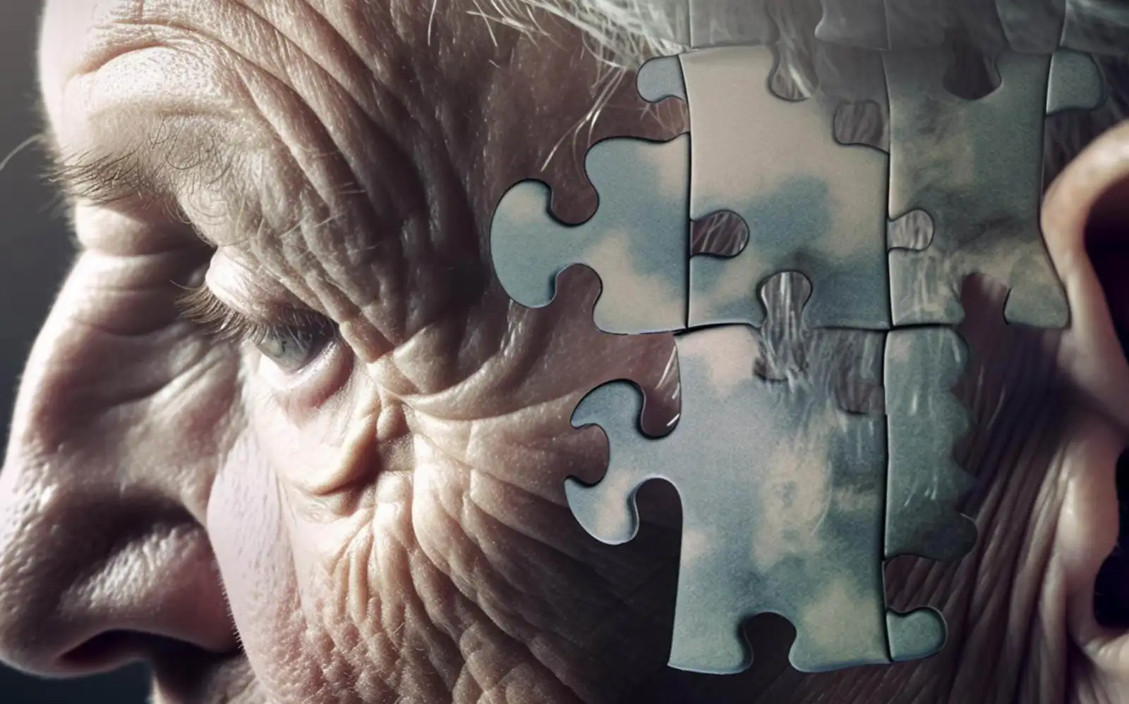
Introduction
Demencia: set of symptoms related to cognitive impairment.
It affects memory, thinking, behaviour and the ability to perform everyday activities
There is currently no cure. The pharmacologiccal treatments applied are not very effective.
Current trend: early detection
© https://www.freemalaysiatoday.com/category/leisure/2024/10/16/how-early-detection-can-prevent-and-slow-dementia/ , under a Creative Commons Attribution 4.0 International License
Can the way people sleep serve as an indicator of their cognitive state?

Slide 4












Objectives, scope and tools
Objectives & scope
To design a model that reports interesting metrics to serve as a basis for future studies
To explore the relationship between different sleep characteristics and cognitive state
Data handling & processing
Machine & Deep Learning
Sleep analysis
Tech stack used
© Icons by Wikimedia Commons (under a Creative Commons Attribution 2.5 Generic License) or under other comercial licenses (The 2-clause BSD License, other CC licenses)
Sustainable Development Goals

Slide 5
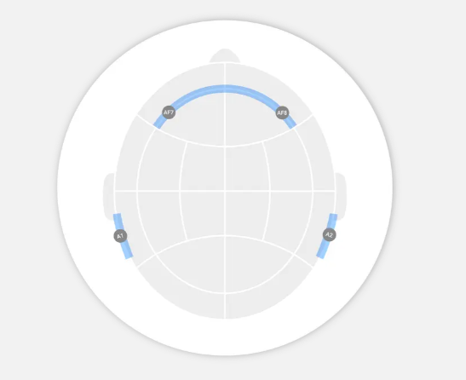
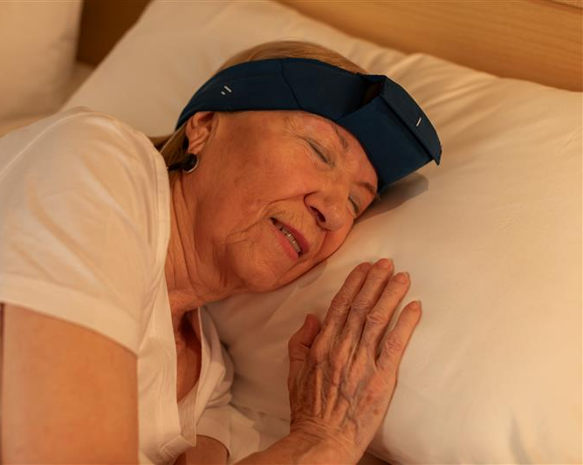
EEG device: Ikon Sleep
Electroencephalogram (EEG): set of signals that allow visualisation of the electrical activity of the brain
Ikon Sleep channels position
Ikon Sleep device example of use
Images from Bitbrain

Slide 6
State-of-the-art
Elisa Ye et. al., 2023
Dementia detection from brain activity during sleep
8044 PSGs
AUROCs with SVM: 0.78 H vs DEM, 0.73 H vs MCI, 0.76 MCI vs DEM
Aurora D’Atri et. al., 2021
EEG alterations during wake and sleep in mild cognitive impairment and Alzheimer’s disease
Descriptive study: patients with AD have fewer slow waves and more changes in delta activity
Duyan Geng et. al., 2022
Sleep EEG-Based Approach to Detect Mild Cognitive Impairment
40 PSGs
RNN accuracy (GRU): 93.46%
Ameya Chatur et. al., 2024
Advanced Classifiers abd Feature Reduction for Accurate Insomnia Detection Using Multimodal Dataset
22 subjetcs, multimodal data
RF accuracy: 95.83%
SVM accuracy: 91.67%
Comparison of sleep and wake EEG biomarkers in mild cognitive impairment and Alzheimer’s disease
Descriptive study: Alzheimer’s patients sleep les and with shorter REM phases
Amir H. Meghdadi et. al., 2023
2025

Slide 7
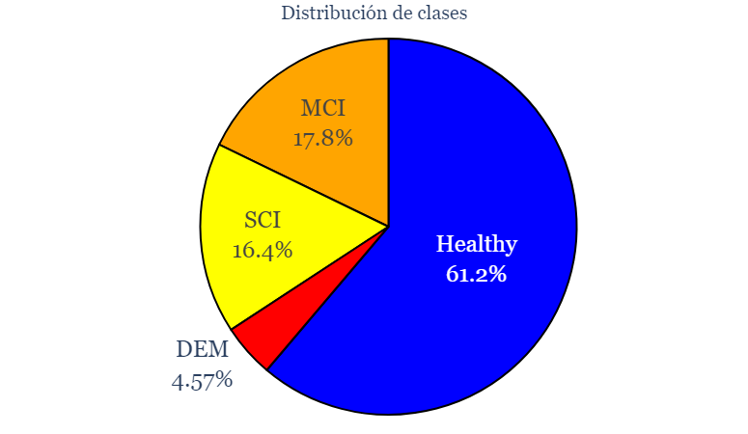

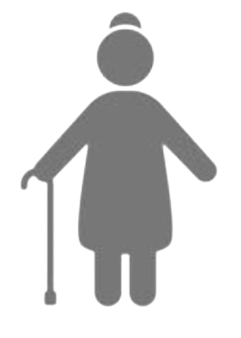


Methods: Dataset
Bitbrain Open Access Sleep Dataset (BOAS), 2024
Healthy - H: healthy person. Control group.
Subjective Cognitive Impairment - SCI: they perceive problems in recalling/retaining information. Their scores on cgnitive tests are too high to be categorised as impaired.
Mild Cognitive Impairment - MCI: intermediate stage. Memory and/or language problems. Independence based on strategies.
Dementia – DEM: it affects memory, language, thinking and ability to carry out daily activities. Changes in personality and behaviour..
Cognitive states distribution (%) from subjects sessions
No cognitive impairment
Cognitive impairment
Healthy
SCI
MCI
DEM

Slide 8
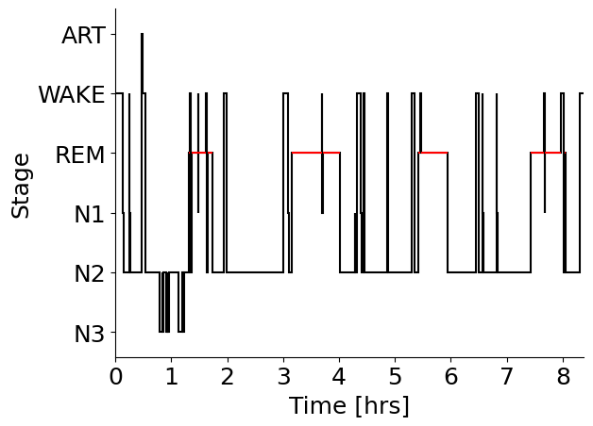
Methods: Sleep macrostructure study
Sessions (nights) divided in 30-seconds windows:
W (0 - awake): waking state with elevated brain activity
N1 (1 - No REM 1 stage): first stage of sleep. Minor stage between wakefulness and sleep
N2 (2 - No REM 2 stage): consolidated light sleep
N3 (3 - No REM 3 stage): deep sleep, important for physical recovery and memory consolidation
REM (4 – REM stage): rapid eye movement sleep. Associated with vivid dreaming and cognitive consolidation
“Art” (-1 – Artifacts): network has not assigned a valid label to these windows due to noise or insufficient data
Hypnogram example from subject 18 (healthy), session 2

Slide 9
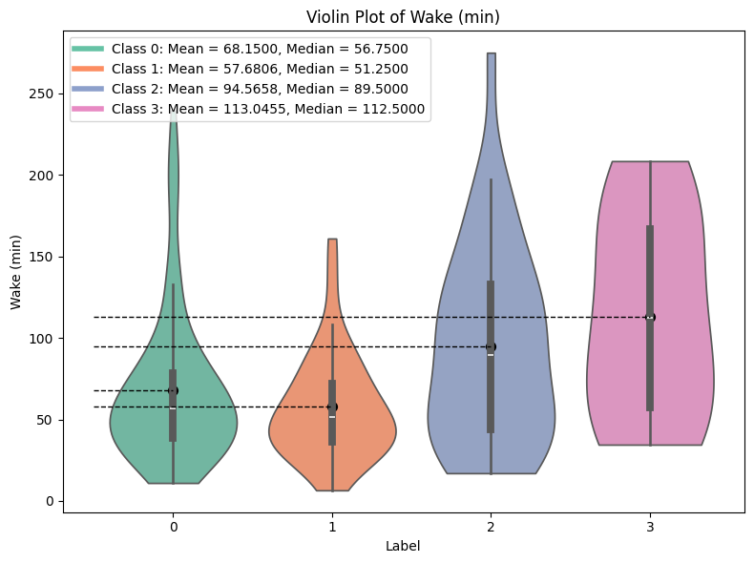
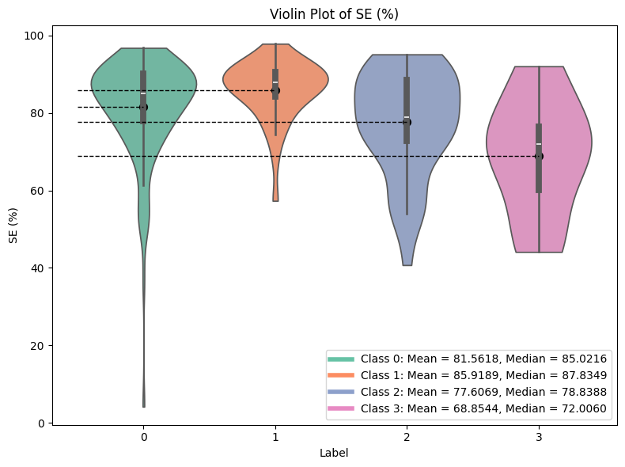
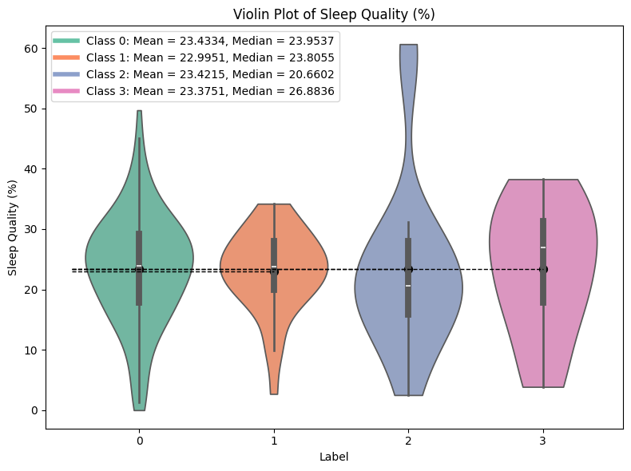
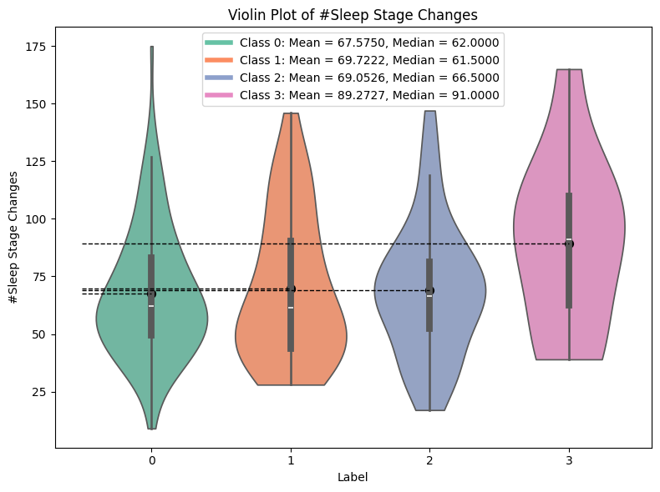
Methods: Sleep macrostructure study
Features derived for sleep stages:
Durations
Transitions
Percentages
Latencies
Quality & Efficiency metrics
Total times
Others
a)
b)
c)
d)
Violin plots showing the distributions of some features derived from sleep stages according to the cognitive state: total duration in W stage (a)), sleep efficiency (SE) percentage (b)), sleep quality (SQ) percentage (c)) and total number of transitions between stages (d)).

Slide 10
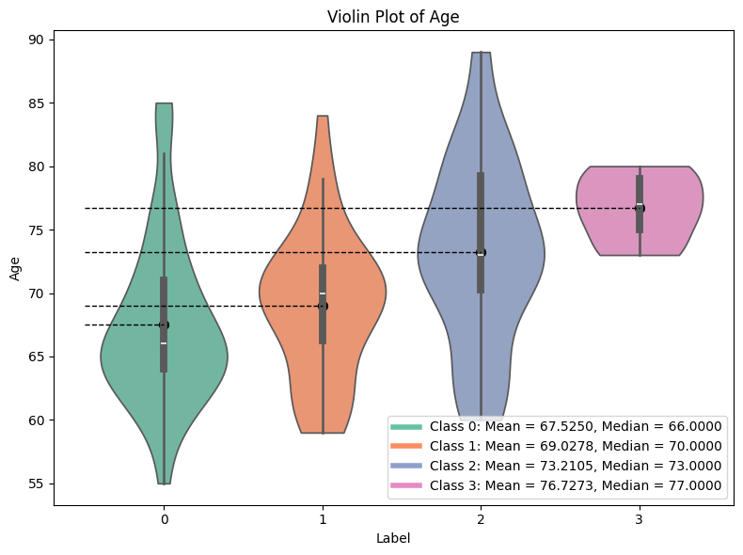
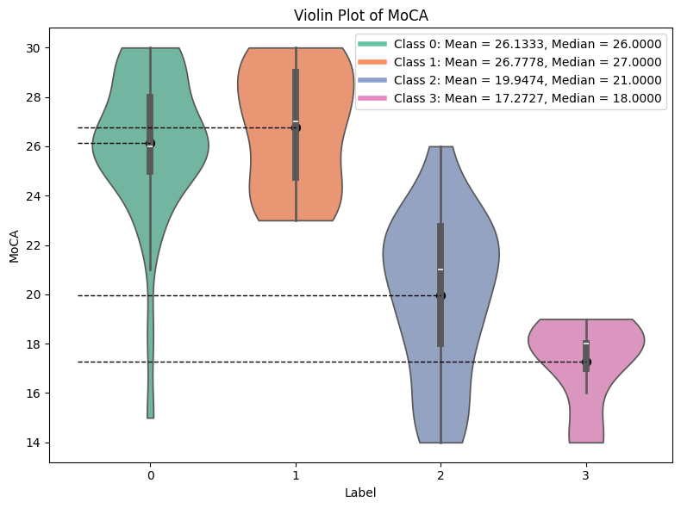
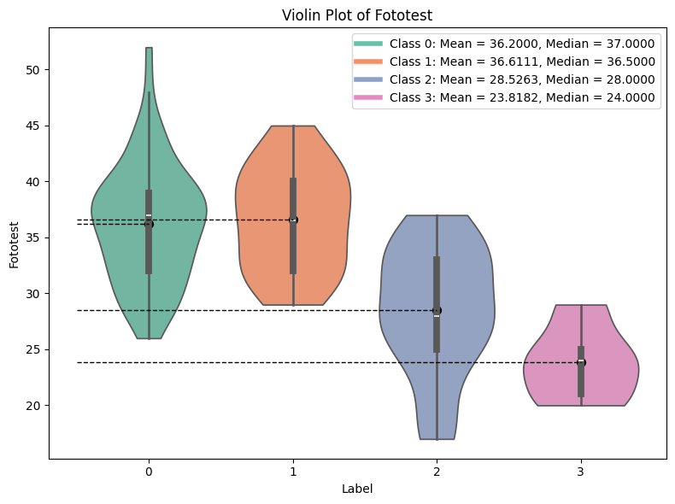
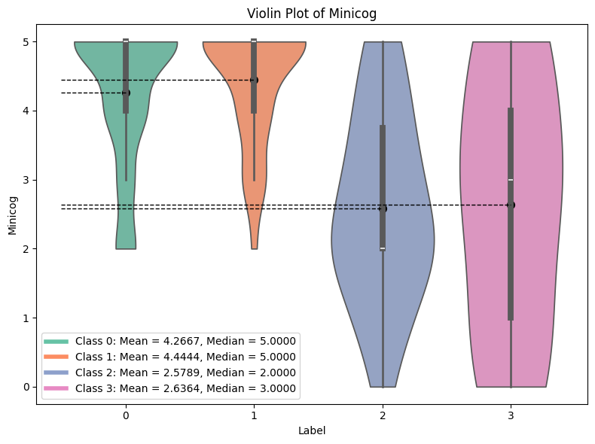
Age and cognitive tests
a)
Information with high discriminatory power between classes
b)
c)
d)
Vviolin plots showing the distributions of age and some cognitive tests according to cognitive state: age (a)), MoCA test (b)), Phototest (c)) and MiniCog test (d))

Slide 11
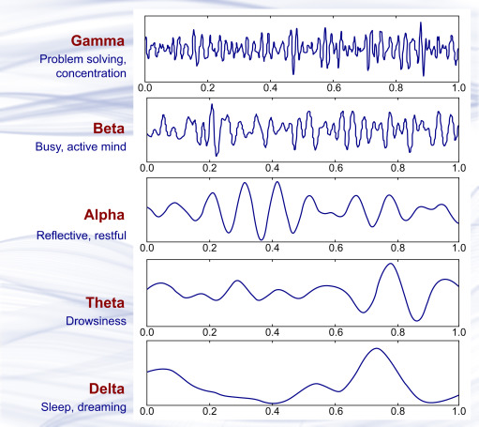
Methods: Sleep microestructure study
Visualization of different EEG frequencies over time
Time & Frequency domains features
Time domain
Line length
Kurtosis
Frequency domain
Band relative powers
Relative power ratios
Bands kurtosis
Frecuencias individuales y potencias de sub-bandas α
Transition Frequency (TF)
Individual Alpha Frequency (IAF)
Power Spectral Distribution(PSD) from α sub-bands
Spindles & slow waves
Spindles: duration, amplitude, frequency, total number per channel, average number per window…
Slow waves: duration, frequency, PTP, total number per channel, average number per window…
Kamble, K., Sengupta, J. A comprehensive survey on emotion recognition based on electroencephalograph (EEG) signals. Multimed Tools Appl 82, 27269–27304 (2023). https://doi.org/10.1007/s11042-023-14489-9

Slide 12
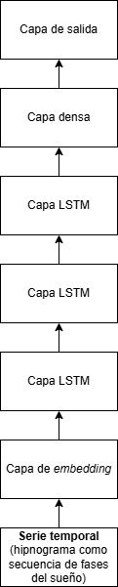
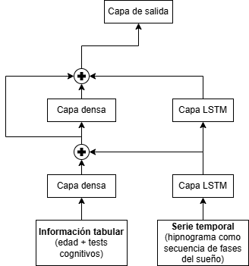



Methods: Used models - Deep Learning
Deep Neural Network – DNN
Recurrent Neural Network – RNN
Hibrid model:
RNN layers + Dense layers
Output
layer
Output layer
Dense
layer
LSTM
layer
Dense layer
LSTM layer
LSTM
layer
LSTM
layer
Dense layer
LSTM layer
Embedding
layer
Tabular data
(age + cognitive tests)
Time series
(hypnogram as a
sleep stages sequence)
Time series
(hypnogram as a
sleep stages sequence)
Designed with Draw.io
Designed with NN-SVG

Slide 13
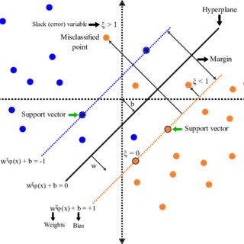
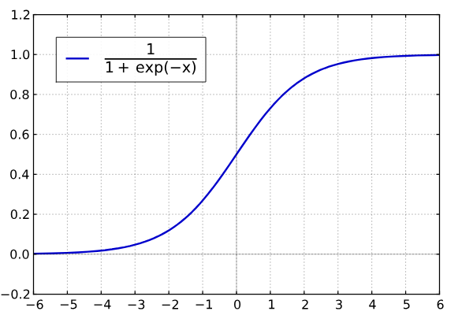
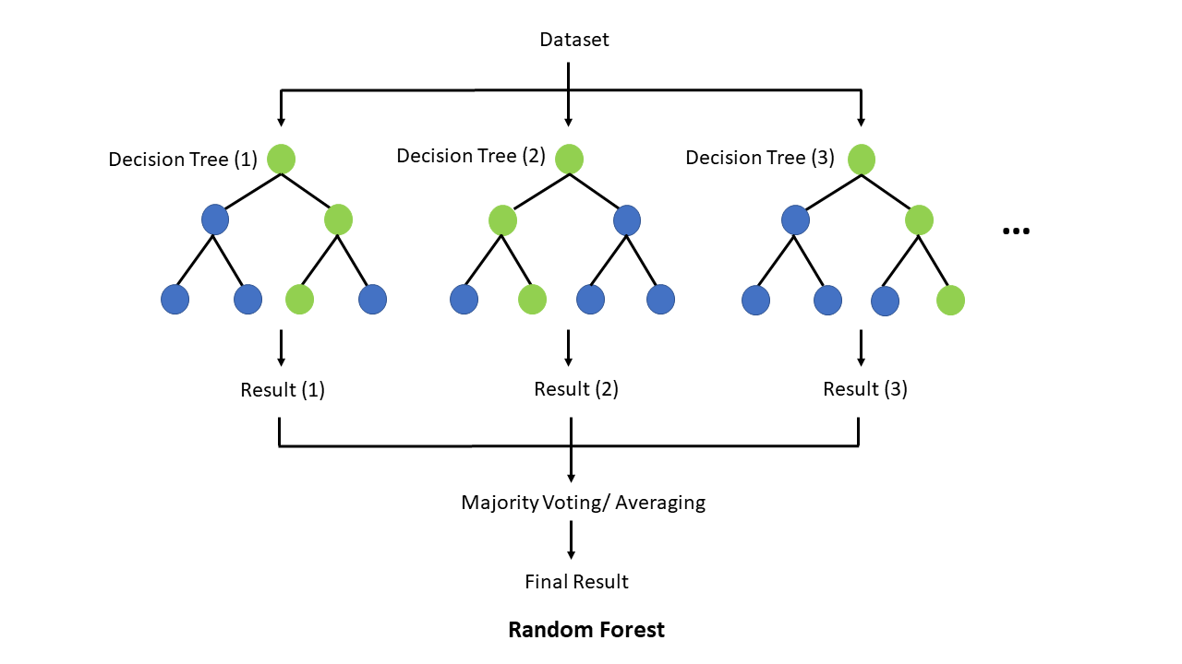

Methods: Used models - Machine Learning
Support Vector Machines – SVMs
Logistic Regression – LR
Random Forests – RFs
© SVM: https://www.researchgate.net/figure/Soft-margin-SVM-Source-Modified-from-Dey-2018_fig4_360635917 , under a Creative Commons Attribution 3.0 Unported License
© LR & RF: Wikimedia Commons, under a Creative Commons Attribution-ShareAlike 4.0

Slide 14
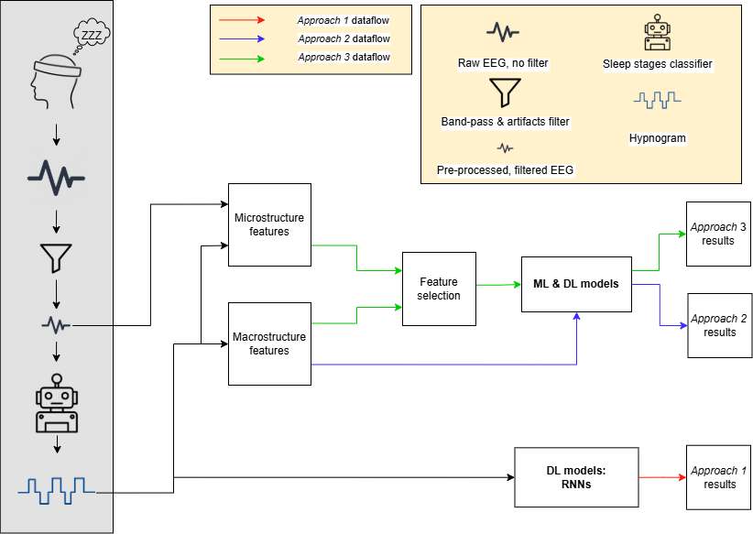
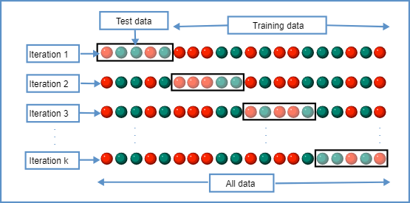
Methods: Evaluation - Experiments
k-fold Cross Validation (k = 10)
© Wikimedia Commons, under a Creative Commons Attribution-ShareAlike 4.0
Project pipeline, showing the data flows of the 3 approaches described, as well as data pre-processing and collection

Slide 15
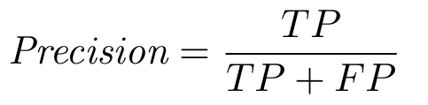
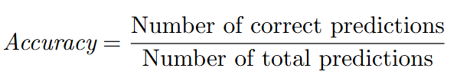
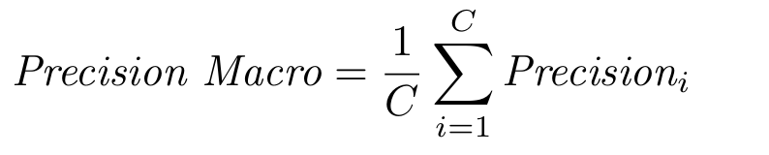
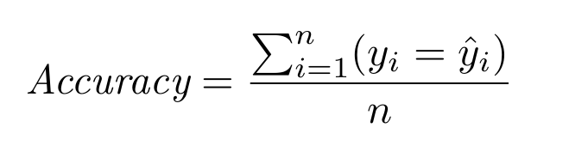
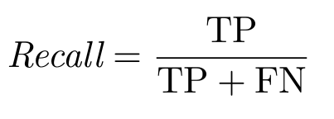
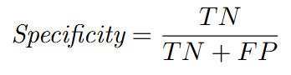

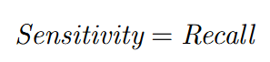
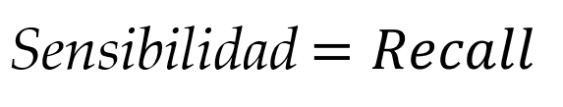
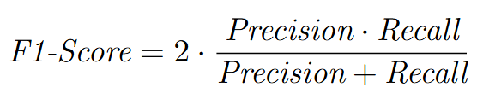
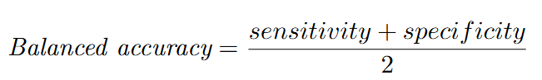
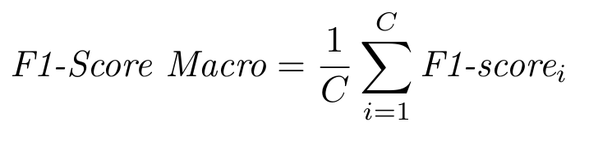
Methods: Evaluation - Metrics
Confusion matrix
 | Class 1 | Class 2
Class 1 | True Positives | False Negatives
Class 2 | False Positives | True Negatives
Actual class
Predicted class

Slide 16
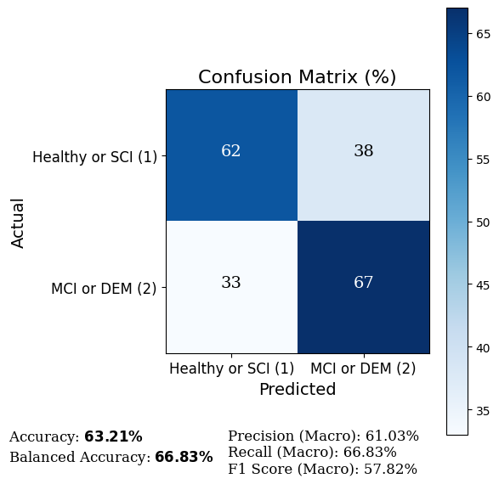
Approach 1 results: sleep stages evolution over time
LSTM4 model results, trained during 200 epochs for label configuration 2

Slide 17
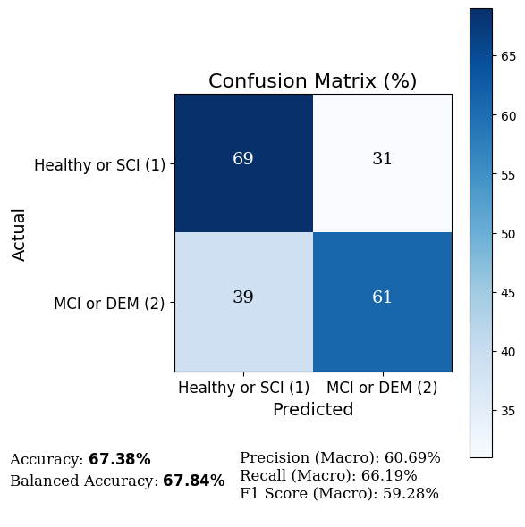
Approach 2 results: features derived from sleep stages
DNN1 model results, trained during 200 epochs for label configuration 2

Slide 18
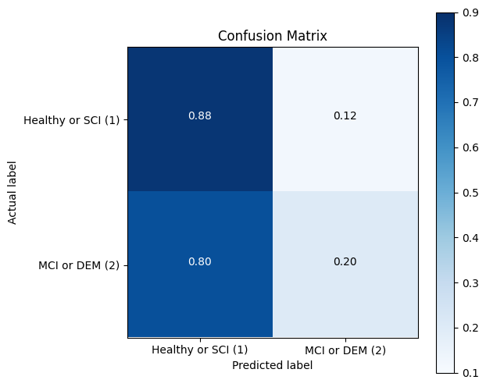
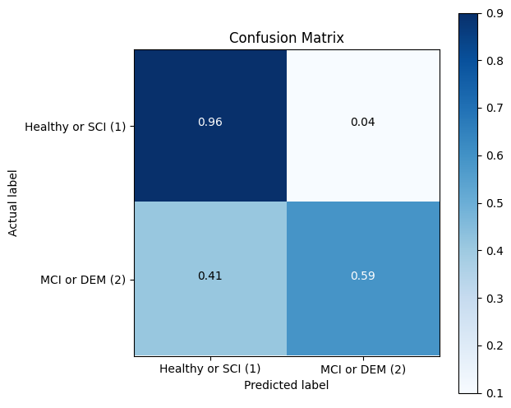
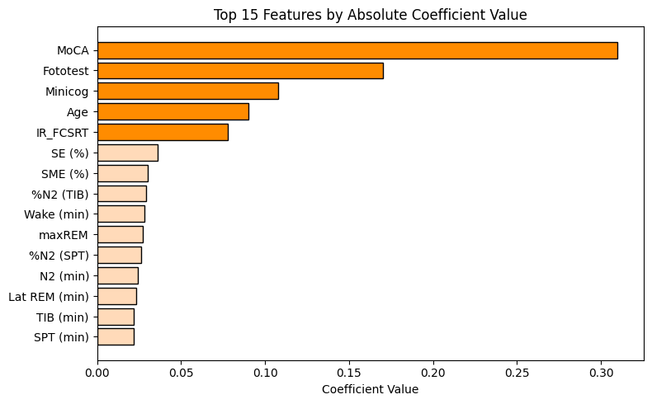
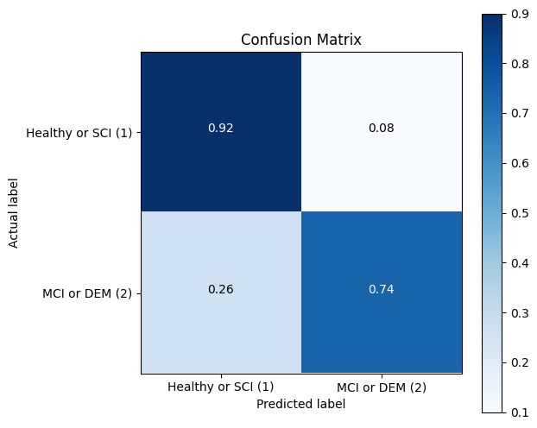
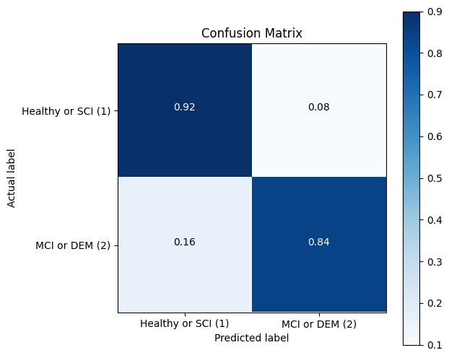
Approach 2 parallel study: cognitive tests and age influence
a)
b)
Diferencia de importancias entre features
c)
Difference in RFC model results for labelling configuration 2 when using only features derived from sleep stages (a)), features derived + cognitive tests and age (b)), top 10 derived features + cognitive tests and age (c)), and only cognitive tests and age
d)

Slide 19
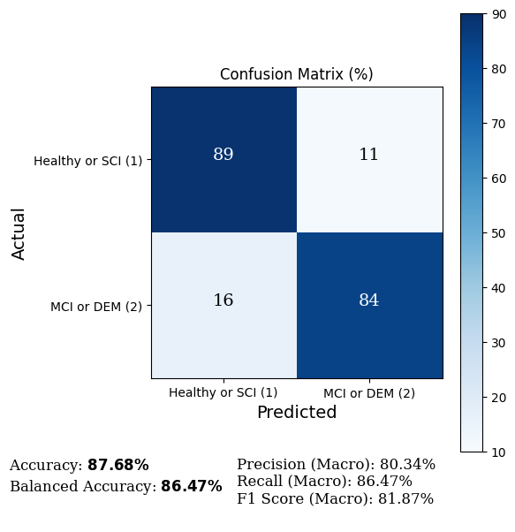
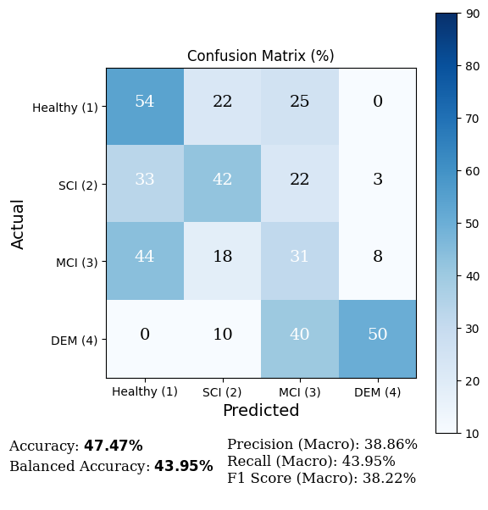
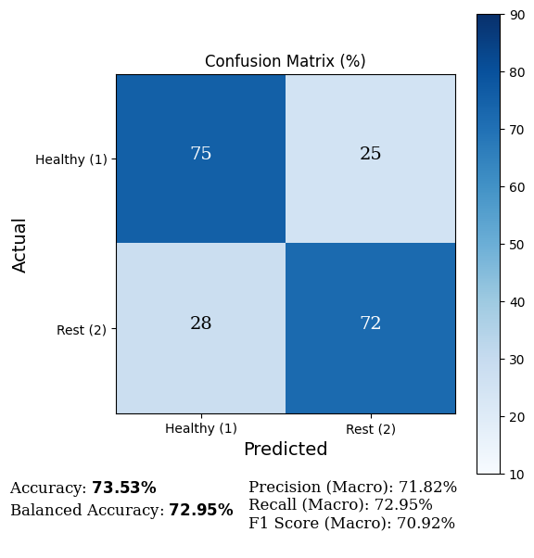
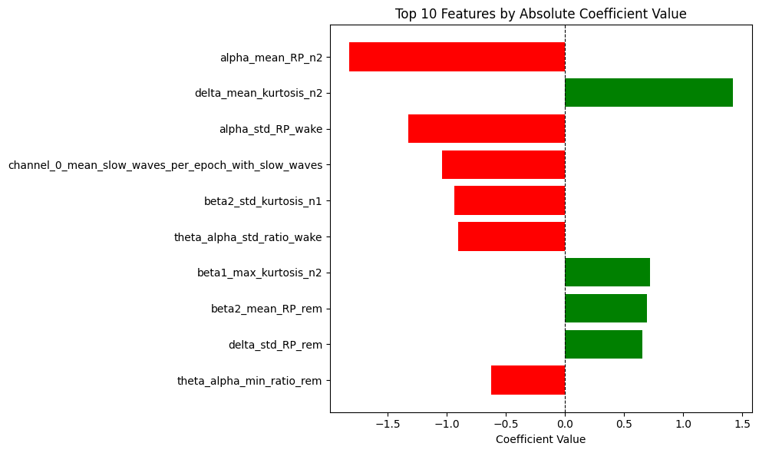
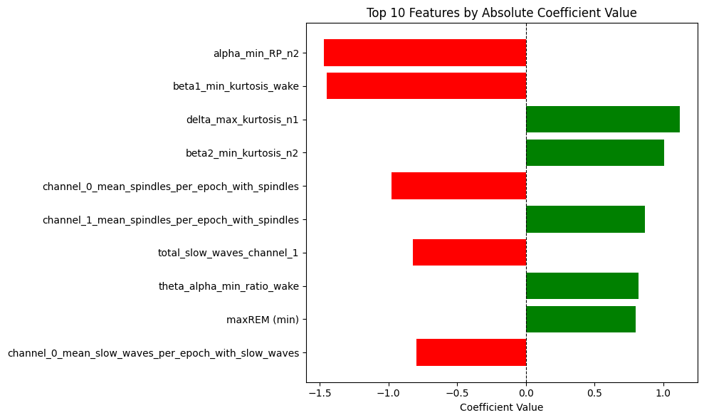
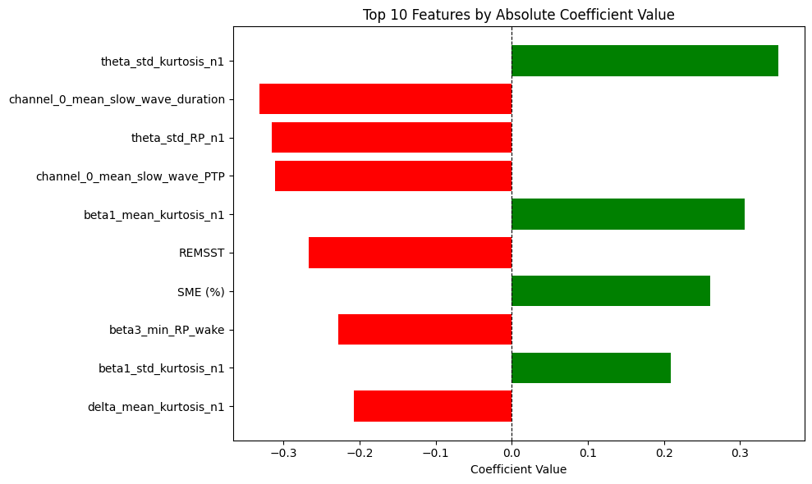
Approach 3 results: microstructure and macrostructure combination - SVMs
Linear SVM model results by labelling configuration, next to the top 10 feature importance coefficients

Slide 20
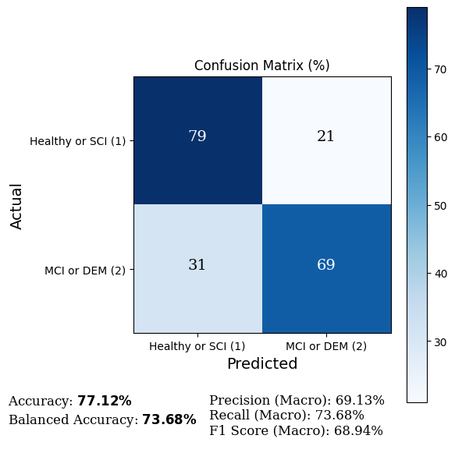
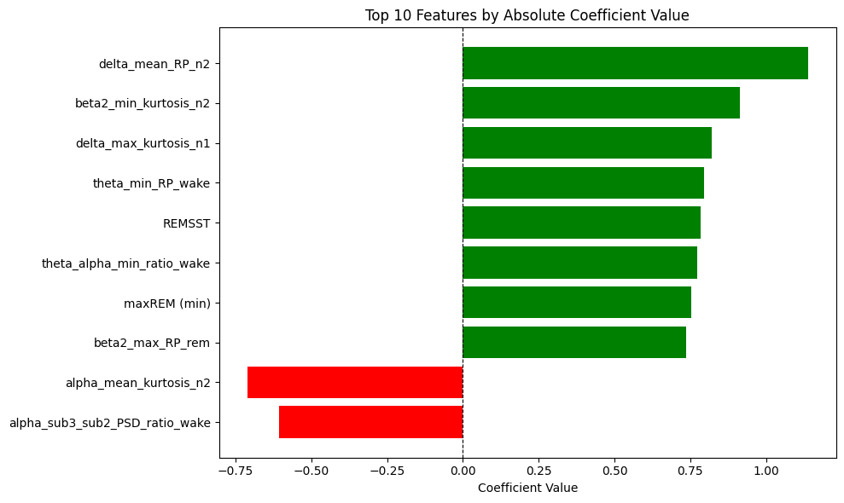
Approach 3 results: microstructure and macrostructure combination - LR
LR model results for labelling configuration 2, next to the top 10 feature importance coefficients

Slide 21
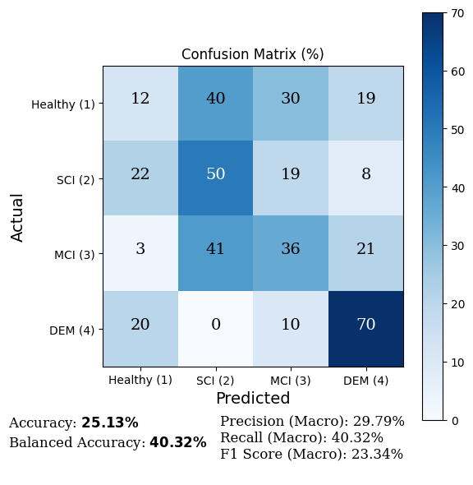
Approach 3 results: microstructure and macrostructure combination - DNNs
DNN2 model results for labelling configuration 2

Slide 22
Conclusions and future work
Top discriminative features:
α (y δ in LR) relative Powers in N2 stage
β1 and β2 band kurtosis
Slow waves features: average number, PTP (peak-to-peak ), average duration
Spindles features: average numbers(opposite importance coefficients between channels))
REM stage: max duration and REM stage transitions
Conslusions:
Features related to memory consolidation, neuronal plasticity and general brain health maintenance are reported as discriminative
Best results obtained when dividing people without cognitive impairment (H and SCI) vs those who do have cognitive impairment (MCI and DEM)
Future work:
Other architectures (attention mechanisms, convolutional networks, specialized architectures…)
Different filter and preprocessing methods
Add socio-demographic data
Use more participants, and more balanced across labels

Slide 23
Bibliography
World Health Organization. (2023). Dementia. https://www.who.int/news-room/fact-sheets/ detail/dementia#:∼:text=Alzheimer%20disease%20is%20the%20most%20common% 20form%20and%20may%20contribute,frontal%20lobe%20of%20the%20brain)
Lam, A. K. F., Carrick, J., Kao, C.-H., Phillips, C. L., Zheng, Y. Z., Yee, B. J., Kim, J. W., Grunstein, R. R., Naismith, S. L., & D’Rozario, A. L. (2024). Electroencephalographic slowing during REM sleep in older adults with subjective cognitive impairment and mild cognitive impairment. Sleep, 47, zsae051. https://doi.org/10.1093/sleep/zsae051
Ye, E. M., Sun, H., Krishnamurthy, P. V., Adra, N., Ganglberger, W., Thomas, R. J., Lam, A. D., & Westover, M. B. (2023). Dementia detection from brain activity during sleep. Sleep, 46, zsac286. https://doi.org/10.1093/sleep/zsac286
Danielle Pacheco, D. A. S. (2023). How Much Does A Sleep Study Cost? https://www. sleepfoundation.org/sleep-studies/how-much-does-a-sleep-study-cost
D’Atri, A., Scarpelli, S., Gorgoni, M., Truglia, I., Lauri, G., Cordone, S., Ferrara, M., Marra, C., Rossini, P. M., & De Gennaro, L. (2021). EEG alterations during wake and sleep in mild cognitive impairment and Alzheimer’s disease. iScience, 24, 102386. https://doi.org/10. 1016/j.isci.2021.102386
Geng, D., Wang, C., Fu, Z., Zhang, Y., Yang, K., & An, H. (2022). Sleep EEG-Based Approach to Detect Mild Cognitive Impairment. Frontiers in Aging Neuroscience, 14, 865558. https://doi.org/10.3389/fnagi.2022.865558
Chatur, A., Haghi, M., Ganapathy, N., TaheriNejad, N., Seepold, R., & Madrid, N. M. (2024). Advanced Classifiers and Feature Reduction for Accurate Insomnia Detection Using Mul timodal Dataset. IEEE Access, 12, 150664-150678. https://doi.org/10.1109/ACCESS. 2024.3456904
Acharya, M., Deo, R. C., Tao, X., Barua, P. D., Devi, A., Atmakuru, A., & Tan, R.-S. (2025). Deep learning techniques for automated Alzheimer’s and mild cognitive impairment di sease using EEG signals: A comprehensive review of the last decade (2013- 2024). Computer Methods and Programs in Biomedicine, 259, 108506. https://doi.org/https: //doi.org/10.1016/j.cmpb.2024.108506
Meghdadi, A., Levendowski, D., Kovacevic, N., Hamilton, J., Boeve, B., St Louis, E., Salat, D., & Berka, C. (2023). Comparison of sleep and wake EEG biomarkers in mild cognitive impairment and Alzheimer’s disease. Alzheimer’s Dementia, 19. https://doi.org/10. 1002/alz.075357
Hugo, J., & Ganguli, M. (2014). Dementia and cognitive impairment: epidemiology, diagnosis, and treatment. Clinics in Geriatric Medicine, 30, 421-442. https://doi.org/10.1016/j. cger.2014.04.001
Sinai, C. (2024). Subjective Cognitive Impairment (SCI). https://www.cedars-sinai.org/health library/diseases- and- conditions/s/subjective- cognitive- impairment- sci.html#: ∼: text=Overview,be%20verified%20by%20standard%20tests.
Esparza-Iaizzo, M., Sierra-Torralba, M., Klinzing, J. G., Minguez, J., Montesano, L., & López Larraz, E. (2024). Automatic sleep scoring for real-time monitoring and stimulation in individuals with and without sleep apnea. bioRxiv. https://doi.org/10.1101/2024.06.12. 597764
López-Larraz, E., Sierra-Torralba, M., Clemente, S., Fierro, G., Oriol, D., Minguez, J., Montesano, L., & Klinzing, J. G. (2024). ”Bitbrain Open Access Sleep Dataset”. OpenNeuro. https://doi.org/doi:10.18112/openneuro.ds005555.v1.0.0
López-Larraz, E., Robledo-Menéndez, A., Jubera-Garcia, E., López-López, A., Simón-Lobera, P., Gelonch, O., De Francisco Moure, J., Marín, J. M., Molina-Torres, N., Osta, R., Lobo, 37 E., Lobo, A., Modrego, P. J., Magallón-Botaya, R., & Minguez, J. (2024). The HOGAR study: Home-based brain monitoring with a self-managed EEG to study cognitive decline in the ageing population. 17th Clinical Trials on Alzheimer’s Disease (CTAD) Conference.

Slide 24
Bibliography
BioSource Faculty. (2024). A Deep Dive into the Delta Rhythm. https://www.biosourcesoftware. com/post/a-deep-dive-into-the-delta-rhythm#:∼:text=Delta%20waves%20are%20a% 20hallmark,synaptic%20pruning%2C%20and%20memory%20consolidation.
Kendra Cherry. (2023). What Are Alpha Brain Waves? Increasing alpha waves may reduce depression. https://www.verywellmind.com/what-are-alpha-brain-waves-5113721
Priyanka A. Abhang, S. C. M., Bharti W. Gawali. (2016). Introduction to EEG-and Speech-Based Emotion Recognition. Science Direct, 19-50. https://doi.org/https://www.sciencedirect. com/topics/agricultural-and-biological-sciences/brain-waves
Wei, Y., Krishnan, G. P., Komarov, M., & Bazhenov, M. (2018). Differential roles of sleep spindles and sleep slow oscillations in memory consolidation. PLoS Computational Biology, 14, e1006322. https://doi.org/10.1371/journal.pcbi.1006322
Prabowo, H., Hidayat, A. A., Cenggoro, T. W., Rahutomo, R., Purwandari, K., & Pardamean, B. (2021). Aggregating Time Series and Tabular Data in Deep Learning Model for Uni versity Students’ GPA Prediction. IEEE Access, 9, 87370-87377. https://doi.org/10. 1109/ACCESS.2021.3088152
Roshan Nayak. (2022). Focal Loss: A better alternative for Cross-Entropy. https://towardsdatascience. com/focal-loss-a-better-alternative-for-cross-entropy-1d073d92d075
Venkat, N. (2018). The Curse of Dimensionality: Inside Out. https://doi.org/10.13140/RG.2.2. 29631.36006
Welch, P. (1967). The use of fast Fourier transform for the estimation of power spectra: A method based on time averaging over short, modified periodograms. IEEE Transactions on Audio and Electroacoustics, 15, 70-73. https://doi.org/10.1109/TAU.1967.1161901
Amanatullah. (2023). Vanishing Gradient Problem in Deep Learning: Understanding, Intuition, and Solutions. https://medium.com/@amanatulla1606/vanishing-gradient-problem-in deep-learning-understanding-intuition-and-solutions-da90ef4ecb54
Wikipedia. (2024). Hinge loss. https://en.wikipedia.org/w/index.php?title=Hinge loss&oldid= 1239477748
Nagpal, A. (2017). L1 and L2 Regularization Methods. https://towardsdatascience.com/l1-and l2-regularization-methods-ce25e7fc831c
Ruder, S. (2017). An overview of gradient descent optimization algorithms. https://arxiv.org/ abs/1609.04747
Yadav, H. (2022). Dropout in Neural Networks. https://towardsdatascience.com/dropout-in neural-networks-47a162d621d9
Grober, E., Sanders, A. E., Hall, C., & Lipton, R. B. (2010). Free and cued selective remin ding identifies very mild dementia in primary care. Alzheimer Disease and Associated Disorders, 24, 284-290. https://doi.org/10.1097/WAD.0b013e3181cfc78b
Perez-Valero, E., Lopez-Gordo, M. ´ A., Guti´ errez, C. M., Carrera-Mu˜noz, I., & V´ ılchez-Carrillo, R. M. (2022). A self-driven approach for multi-class discrimination in Alzheimer’s disease based on wearable EEG. Computer Methods and Programs in Biomedicine, 220, 106841. https://doi.org/https://doi.org/10.1016/j.cmpb.2022.106841
Martin-Loeches, M., Garcia-Trapero, J., Gil, P., & Rubia, F. J. (1991). Topography of mobility and complexity parameters of the EEG in Alzheimer’s disease. Biological Psychiatry, 30, 1111-1121. https://doi.org/10.1016/0006-3223(91)90181-k

Slide 25
Thank you so much!
Óscar Brizuela
This work is licensed under Creative Commons Attribution-NonCommercial 4.0 International

